Slide 1
Prefetch Procrastinator for Android

Slide 2
Project Description
Prefetched contents at the time of launch gets rendered quickly and improves user experience
Unavoidable data usage

Slide 3
Design
Android Common Pattern
Activity 1{
var1 <= networkFetch(url1)
var2 <= networkFetch(url2)
startActivity2(var2)
}
Activity 2{
textView.setText(var2)
}

Slide 4
Design
Detect n/w prefetch variables
n/w call for prefetch variable
Use of prefetch variable (var2) detected
Store the URL (url2) and corresponding variable (var2)
No
Connected to Wi-fi
Yes
Execute network call for prefetch

Slide 5
Method – Find Patterns
Most common pattern (Screenshot of a code snippet explaining pattern)
Prefetched variables are being used in other activities

Slide 6
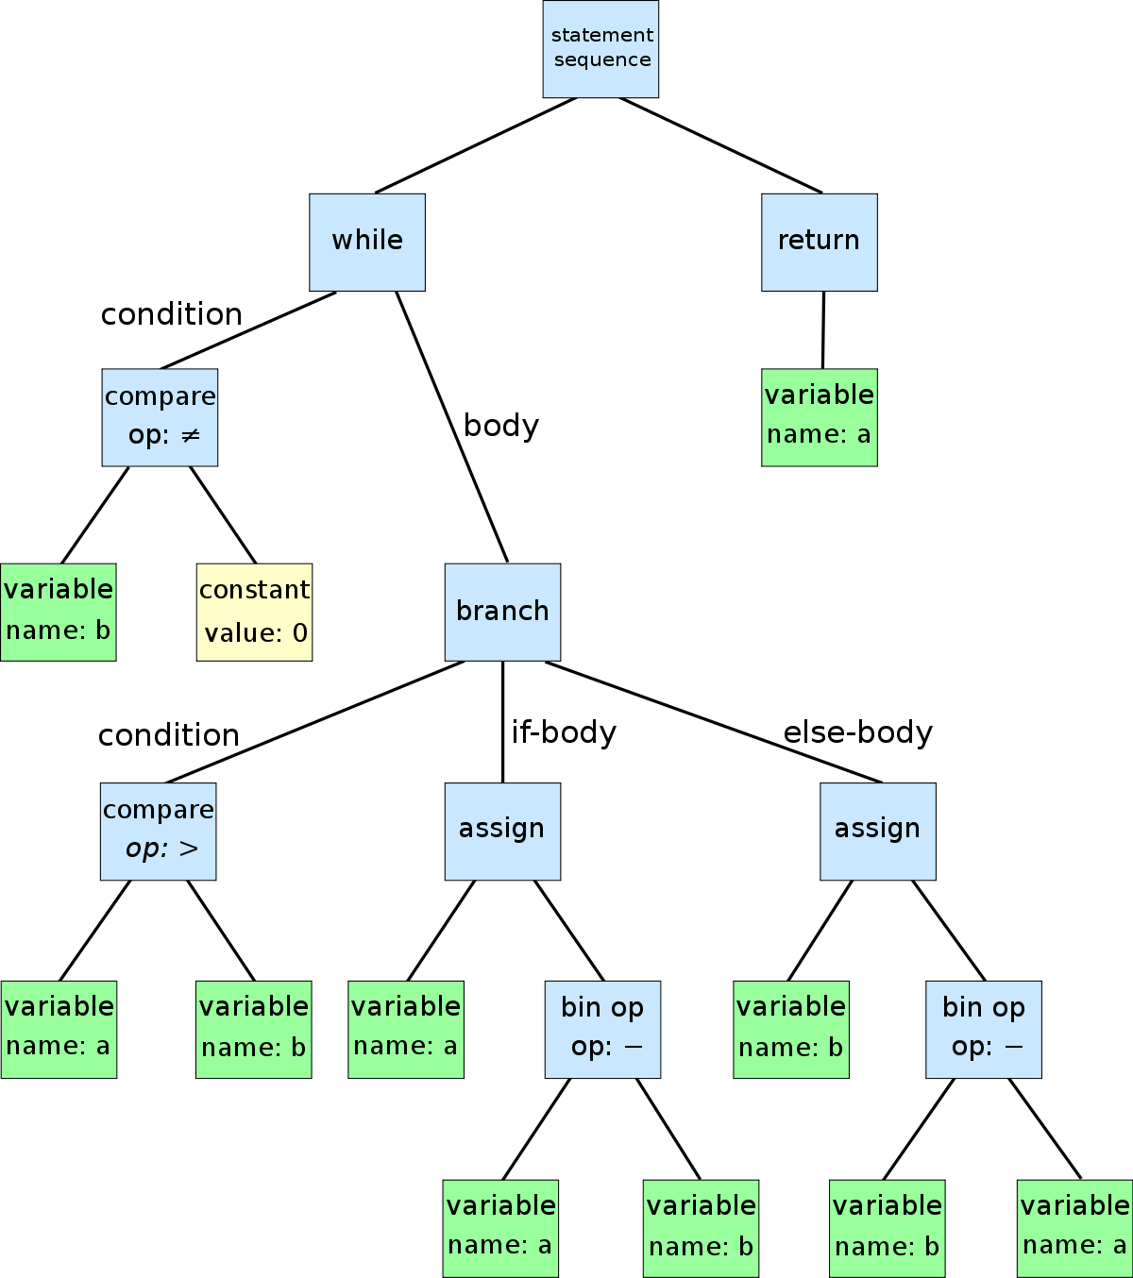
Method – Static Analysis: ASTs

Slide 7
Method – Static Analysis: General
Track Intent Calls
Created a new AsyncTask with the respective URL that will executed procrastinated calls
This AsyncTask object will be called and executed when the new activity using the prefetch variable is executed
No
Prepare a list of all the variables passed in intent
Is variable a network call?
Instrument the network call with procrastination condition
Yes

Slide 8

Method – Track User Movements
Detect n/w prefetch variables
n/w call for prefetch variable
Use of prefetch variable (var2) detected
Store the URL (url2) and corresponding variable (var2)
No
Connected to Wi-fi
ViewPrefetch
Correlation
Yes
Execute network call for prefetch

Slide 9
Method
Detailed explanation of view prefetch

Slide 10
Evaluation
How many users?
Days?
What all things were tracked?
Graphs and Charts

Slide 11
Conclusion
This work definitely suggests that there is some scope tracking user movements and using it for procrastination
(Insert some key results)
With our design, it is possible to procrastinate HTTP POST method
Bytecode instrumentation would make the static analysis more generalized
In this work, we are targeting a fundamental network design in Android, hence with minor modification it should work with various network libraries.

